Slide 1
MSc Software Development
Programming
Methods

Slide 2

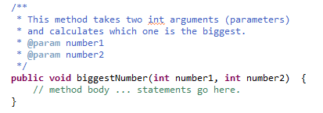
Methods
A Java method is a collection of statements that are grouped together to perform an operation. When you call the System.out.println method, for example, the system actually executes several statements in order to display a message on the console.
Now you will learn how to create your own methods with or without return values, and invoke a method with or without parameters.
The only required elements of a method declaration are the method's return type, name, a pair of parentheses() and a body between braces {}
A method signature is simply the method name and parameter types.

Slide 3
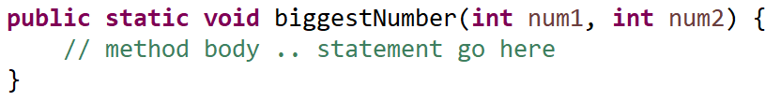
Method format
visibility [static] return-type method-name (parameter-list) { statements...
}
The optional keyword static declares that the method is a static method, which means that you can call it without first creating an instance of the class in which it’s defined.
The return type, indicates whether the method returns a value when it is called — and if so, what type the value is e.g. int, double, String etc. If the method doesn’t return a value, specify void.
If you specify a return type other than void, the method must end with a return statement that returns a value of the correct type.
Parameter list : You can pass one or more values to a method by listing the values in parentheses following the method name. The parameter list in the method declaration lets Java know what types of parameters a method should expect to receive and provides names so that the statements in the method’s body can access the parameters as local variables.
If the method doesn’t accept parameters, you must still code the parentheses that surround the parameter list. You just leave the parentheses empty.
The visibility of a method determines whether the method is available to other classes. The options are public: Allows any other class to access the method private: Hides the method from other classes protected: Enables subclasses to use the method but hides the method from other classes outside the package
The rules for making up method names are similar to variables : Use any combination of letters and numbers, but start with a letter (lower case) and make it meaningful.
One or more Java statements that comprise the method body, enclosed in a set of braces. The method body requires you to use the braces even if the body consists of only one statement.

Slide 4

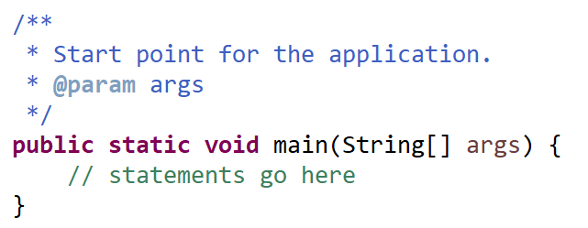

Main method
In Java, within an application you usually have a method named main in at least one class within a package.
It is the start point for an application.
The runtime system starts by calling the specified class's main() method. The main() method then calls all the other methods required to run your application.
It is possible to start the application from a command line and provide arguments (although we have been letting the IDE do this for us so far !)
Remember to Javadoc comment all methods
Notes:
The main method can be placed above or below other methods within the same class, but it is usually placed at the beginning of the class for readability and convention.
It's a common practice to organise your code in a way that makes it easy for others (and yourself) to understand and maintain, so placing the main method at the top of the class is a good practice.
However, Java does not enforce a specific order for method placement within a class, so it ultimately depends on your coding style and preferences.

Slide 5
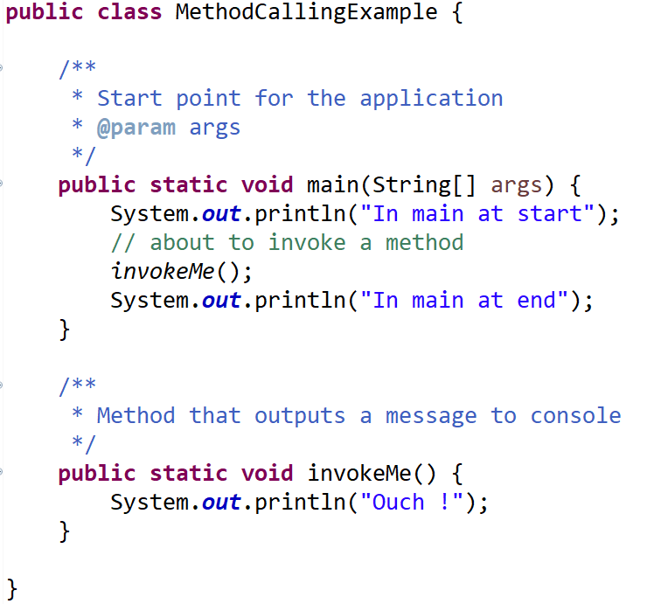
Adding a new method
In main at start
Ouch !
In main at end

Slide 6


Exercises
Create a method that when invoked will write your name to the console
Create a method that when invoked will write your name to the console 10 times
Create a method that when invoked will write your name to the console 1000 times
Write a method that will calculate which year you will turn 100.
To get the current year ..
Hardcode your age as a variable of type int in the method
Notes:
public static void nameToConsole() {
System.out.println("Aidan");
}
public static void nameToConsoleTimes10() {
for (int loop = 1; loop < 11; loop++) {
System.out.println("Aidan");
}
}
public static void nameToConsoleTimes1000() {
for (int loop = 1; loop < 1001; loop++) {
System.out.println("Aidan");
}
}
public static void yearTurn100(){
int currentAge, currentYear, yearTurning100;
currentAge = 30;
yearTurning100 = 0;
currentYear = java.util.Calendar.getInstance().get(java.util.Calendar.YEAR);
yearTurning100 = 100 - currentAge + currentYear;
System.out.println("Year turning 100 is : "+yearTurning100);
}

Slide 7


Methods .. passing values
The last method is good up to a point! It only works for you or anyone who is the same age as you. It would be better to be able to pass the age into the method and then it would become a lot more useful.
Passing a value into a method is called parameter passing.
A method can require one or more parameters that represent additional information it needs to perform its task.
Parameters are defined in a comma-separated parameter list, which is located inside the parentheses that follow the method name.
Each parameter must specify a type and a variable name. The parameter list may contain any number of parameters, including none at all.
Empty parentheses following the method name indicate that a method does not require any parameters.

Slide 8
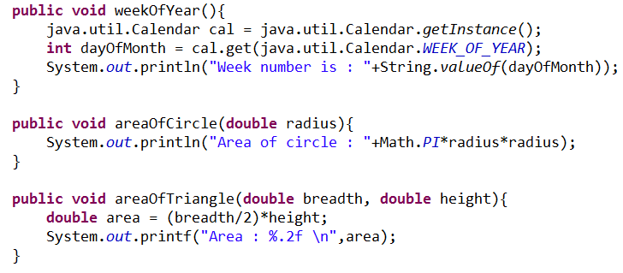
Declaring a method with parameter(s)
Method with no parameters
Method with one parameter, a double (referred to as radius throughout the method)
Method with two parameters, two doubles (breadth and height)

Slide 9
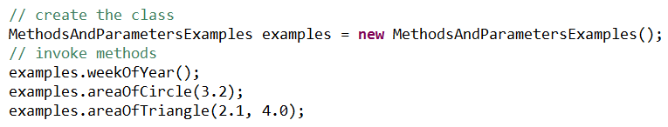
Arguments to a Method
A method call supplies values— called arguments —for each of the method’s parameters.
For example, the method System.out.println requires an argument that specifies the data to output in a command window. e.g. System.out.println(“Hello world”);
For Instance methods (methods that are not marked as static), firstly create (instantiate) the class and then invoke with the correct arguments (correctly ordered data types)
For static methods, you can call (invoke) them directly without instantiating the class.

Slide 10
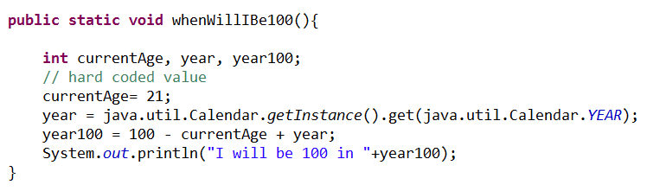
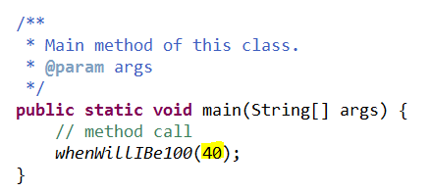

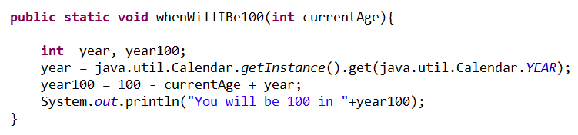
Recall the age method
This would be much more useful if it were parameterised !
Invoking a method with an argument
Parameter added (int currentAge)
That’s better

Slide 11

Methods with parameters
Create a method that will print your name to the console a number of times. Your name and the number of times will be determined by the value passed as a parameter.
Create a method that starts a countdown, ending at zero. 10, 9, 8 etc… The start value of the countdown should be passed as a parameter. (Use a FOR loop for the countdown).
Notes:
public static void outputName(String name, int times){
for (int loop=1; loop<=times; loop++){
System.out.println(name);
}
}
public static void count(int start){
for (int loop=start; loop>=0; loop--){
System.out.println(loop);
}
}

Slide 12
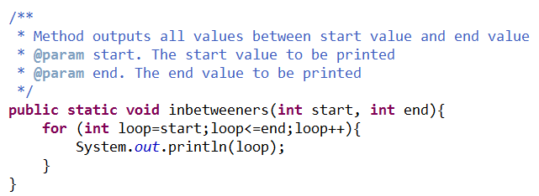
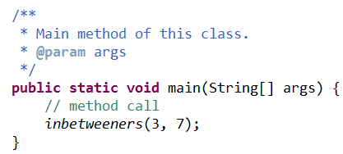

More than one parameter
It’s unlimited .. but don’t use too many! Keep your code readable.

Slide 13
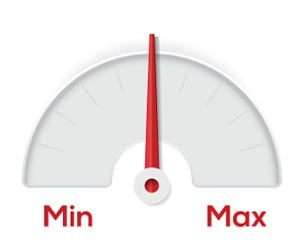

Parameterised method - exercises
Create a method (called min) that takes two arguments (of type int) and outputs (to screen) the min value.
Create a method (called max) that takes two arguments (of type int) and outputs (to screen) the max value.
Average - Create a method (called average) that takes four arguments (of type int representing the life expectancy of four countries) and outputs (to screen) the average life expectancy to two decimal places
(loss of precision … ? Try a cast (double)
int total = a+b+c+d;
double avg = (double)total/4;
Notes:
public static void min(int num1, int num2){
if (num1>num2){
System.out.printf("%d is bigger than %d",num1, num2);
} else if (num2>num1){
System.out.printf("%d is bigger than %d",num2, num1);
} else {
System.out.printf("%d is same as %d",num1, num2);
}
}
public static void average(int a, int b, int c, int d) {
int total = a+b+c+d;
double avg = (double)total/4;
System.out.printf(“Life expectancy average %.2f”,avg);
}

Slide 14

Methods with a return
A method returns to the code that invoked it when it
completes all the statements in the method
reaches a return statement
throws an exception (covered later)
(whichever occurs first).
You declare a method's return type in its method declaration.
Within the body of the method, you use the return statement to return the value.
Any method declared void doesn't return a value. It does not need to contain a return statement
Any method that is not declared void must contain a return statement with a corresponding return value, like this:
return returnValue;
The data type of the return value must match the method's declared return type; you can't return an int value from a method declared to return a boolean.

Slide 15
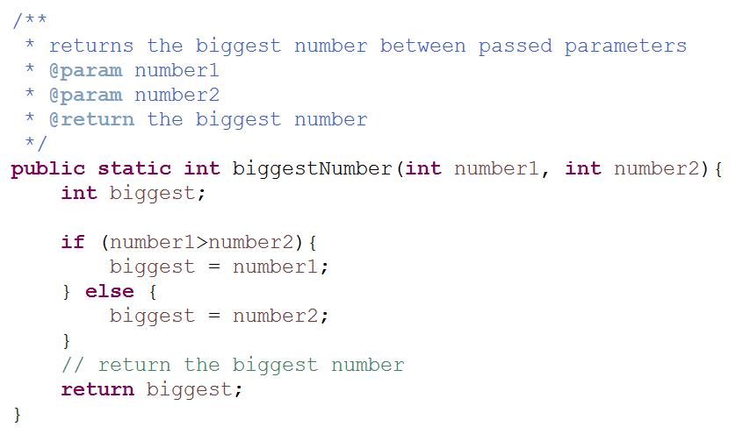
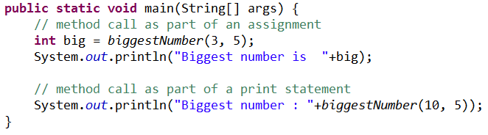

Methods with a return
The declared return type
The return (needs to match the type declared above)

Slide 16
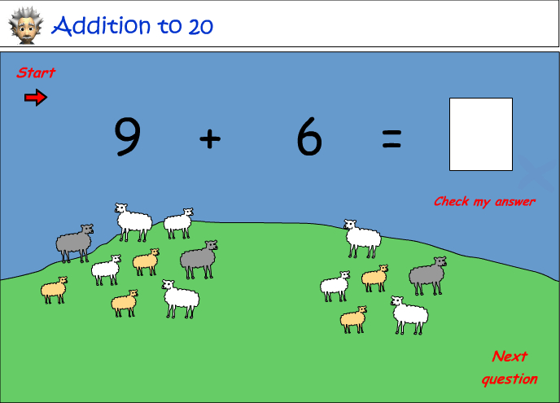
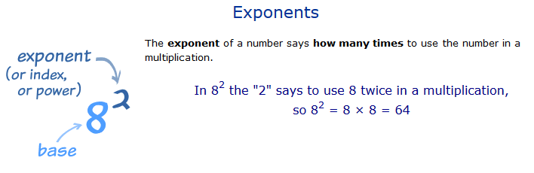
Methods with a return - exercises
Create an application with a method that adds two numbers together. The result should be returned from the method and displayed.
Now using the arithmetic operators add additional methods to create a simple calculator
Create method that will use the Math.pow(double number, double exponent) to calculate a number multiplied a specified number of times by itself.
The number and exponent should be passed to the method as a parameter argument.
Notes:
/**
* Adds two passed parameter values together
* and returns the result.
* @param number1 first number
* @param number2 second number
* @return
*/
public static int add(int number1, int number2){
int answer;
answer = number1+number2;
return answer;
}
// better – more efficient
public static int add(int number1, int number2){
return number1+number2;
}
___________________________________________________________________________________________________________________________________
public class ExponentCalculator {
public static void main(String[] args) {
System.out.println(exponentCalculation(3, 2));
}
public static double exponentCalculation(double number, double power){
return Math.pow(number, power) ;
}

Slide 17

Single responsibility
It is generally considered a good practice for methods to have a single, well-defined purpose. This principle is often referred to as the "Single Responsibility Principle" (SRP), which is one of the SOLID principles of object-oriented design.
The idea behind having a single responsibility for a method is to keep your code clear, maintainable, and easier to understand. When a method has a single purpose, it's easier to:
Understand and Reason About: Developers reading the code can quickly grasp what the method does without having to dig into its implementation details.
Test: Methods with a single purpose are typically easier to test because you can focus on specific inputs and expected outputs.
Maintain: When you need to make changes or fix bugs, having methods with single responsibilities reduces the risk of unintended consequences or introducing new issues.
Reusability: Methods with a single responsibility are often more reusable in different parts of your codebase.
Notes:
Consider the following guidelines for designing methods:
Keep methods concise and focused on solving a specific problem.
Avoid "god methods" or "kitchen-sink" methods that try to do too much.
If you find a method doing more than one thing, consider breaking it down into smaller methods, each with a single responsibility.
However, there can be situations where a method may have multiple steps, but each step still contributes to a single overarching purpose. In such cases, it's essential to strike a balance between maintaining single responsibility and keeping the code practical and readable. Use your judgment and consider the context of your specific application when designing methods.
In summary, while methods are typically best when they have a single purpose, there can be exceptions depending on the nature of the task at hand. Clear and understandable code should always be the primary goal.

Slide 18

“In Java, a method is a block of code that performs a specific task or operation. Methods are essential in programming because they allow us to organise and encapsulate functionality, making code more modular and easier to manage. They also promote code reusability, as methods can be called multiple times from different parts of a program.
Declaring and Calling Methods in Java:
To declare a method in Java, you need to specify its signature, which includes the method's name, return type, and any parameters it accepts. Here's a basic syntax for method declaration:
returnType methodName(parameterType parameterName) {
// Method body
// Perform operations here
return returnValue; // Optional, based on the return type
}
returnType: The data type of the value that the method returns. Use void if the method doesn't return any value.
methodName: The name you give to the method.
(parameterType parameterName): Parameters, if any, that the method accepts. You can have zero or more parameters.
return: The keyword used to return a value from the method (only if the return type is not void).
To call a method, you use the method name followed by parentheses. If the method takes parameters, you pass values inside the parentheses. Here's how you call a method:
returnType result = methodName(argument1, argument2, ...);
Example: Let's consider a simple Java method that calculates the sum of two numbers:
public class Calculator {
public static void main(String[] args) {
int result = add(5, 3); // Calling the 'add' method
System.out.println("Sum: " + result);
}
public static int add(int num1, int num2) {
int sum = num1 + num2;
return sum;
}
}
In this example:
We declare a method named add that takes two int parameters and returns an int.
Inside the method, we calculate the sum of the two numbers and return the result.
In the main method, we call the add method with values 5 and 3, and the result is stored in the result variable.
We then print the result, which is the sum of 5 and 3, and it will be 8.
This demonstrates how methods are declared, called, and used to encapsulate functionality in programs.
”
Interviewer: “what is a method, and what is its significance in programming? Explain how methods are declared and called in Java. Provide a simple example to illustrate your explanation”.
This question focuses on the understanding of methods in the context of Java programming specifically, rather than delving into broader object-oriented programming concepts. It evaluates the candidate's knowledge of Java's method syntax, declaration, and invocation.

